Slide 1
Ease of Doing Business @ Chhattisgarh

Slide 2
Ease of Doing Business @ CG - Overview
S.No. | Particulars | 2015 | 2016
1 | Ranking as per DIPP & World Bank | 04 (Out of 32) | 04 (Out of 36)
2 | Implementation Scorecard | 62.45 % (178 Yes) | 97.32% (327 Yes)
3 | Reform points | 285 reforms | 340 reforms
4 | Broad areas | 8 areas | 10 areas
Consistent Secured 4th position in 2015 & 2016
Leader Been in the Top five lists of both year rankings
Holistic Reforms in every Major Department
As mentioned on the DIPP website out the 10 key reform areas we have 100% implementation in 7 areas:
Environmental Registration Enablers
Labour Regulation Enablers
Obtaining Electricity Connection
Online Tax Return Filing
Access to Information and Transparency
Single Window System
Inspection Reform Enablers

Slide 3
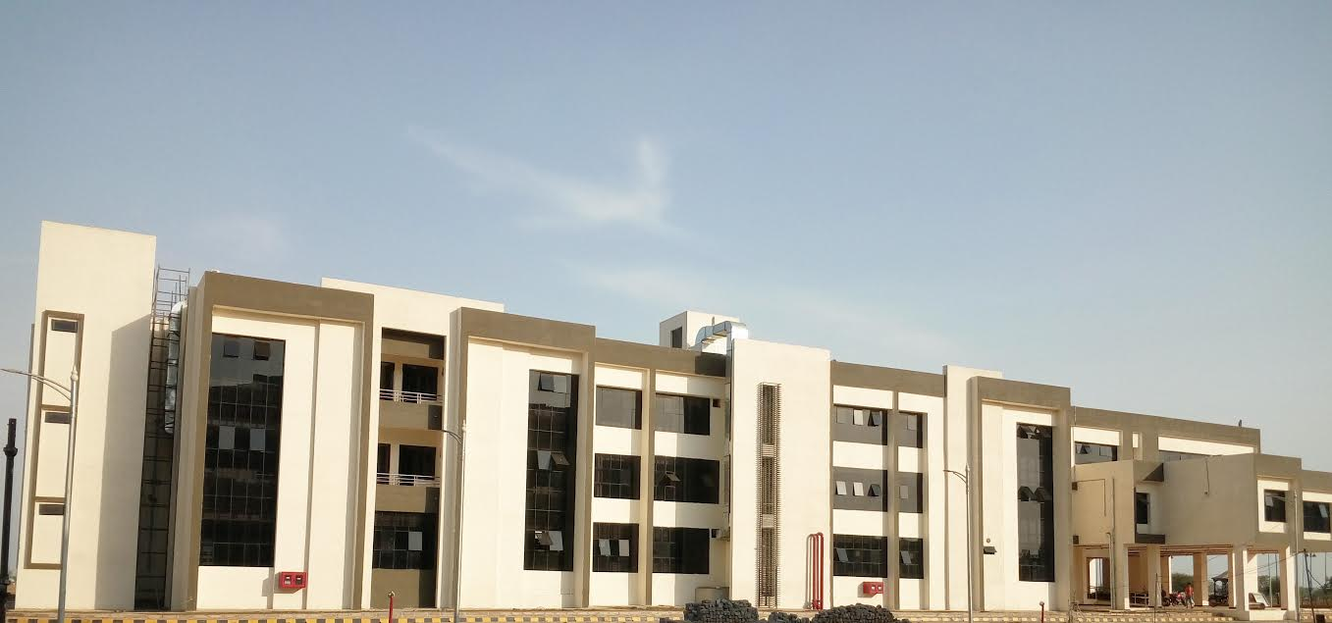
Commercial Dispute Resolution Centre at Naya Raipur
Commercial Dispute Resolution Enablers and Paper-less Courts

Slide 4
Infrastructural Advantage
Arbitration Centre
Mediation Centre
Video Conference Hall
Bar room
Arbitrators and Lawyers Waiting Room
Mediation Room
Litigants’ Waiting Room
Room for Private Secretaries
Separate Record Room
Separate Data Cell
40 LAN connections
Library

Slide 5
Journey so far…

Slide 6
Identification of Departments
Bank
Stock Holding Corporation
High Court
Law & Legislative Department
Industries Department

Slide 7
Challenges Faced
Bench constituted under section 5(1) of the High Court Act, 2015
Required infrastructure was setup in Naya Raipur
Judge was appointed
Every commercial disputes greater than Rs 1 crore fall under the jurisdiction of Commercial Court.
Solutions
Challenges
Constitution of Bench under relevant section of High Court Act, 2015
Infrastructure for commercial court
Appointment of judge
Defining jurisdiction

Slide 8
Establishment of Commercial Court
Industries Dept
High Court
Legislation
Definition of District
Allocation of Space
Development of Space
Judicial Bandwidth
Coordination
Legal Framework
Physical Framework
Presentation by Industries Department to Chief Secretary
Presentation to Chief Justice of High Court
Under relevant section of High Court Act (2015)
Commercial Court in every district
All of Chhattisgarh defined as a Single District
Greater than Rs 1 crore. (Pecuniary Jurisdiction
E-Stamp / Digital Signature
Fully Air conditioned, Arbitration Room, Bar room, Video Conference etc.

Slide 9
Court Fee and Process Fee: Online
High Court
Notification
Bank Account
SHCIL
Payment Gateway
SHCIL
Court Fee
Login
Stock Holding Corporation
Select Court Fee
NEFT
Process Fee
Bank Account
Account number available
Deposit money In that account
Non Judicial E-Stamp

Slide 10
Identify steps in Manual Process
Online Portal for Commercial Disputes
Issuance of E-Summons
E-Payment of Court & Process Fees
E-Filing of Court Cases
Display of E-Cause List
Digitally Signed Court Orders
Filing for commercial disputes in District Courts/Commercial courts
Summons for commercial disputes in District courts/Commercial courts
Publishing Cause Lists for commercial disputes in District courts/Commercial courts
Payment of Court and Process Fees for Judicial Proceedings
Issuance of Court Orders to litigants and in Public Domain

Slide 11
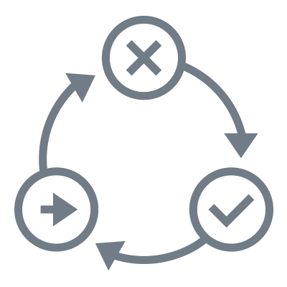
Develop Online Modules
Login Requirements
Payment \ Data gateway
All processes covered
Remove redundant steps
Ensure safeguards
Intra-portal linkage
Portal for Filing of Commercial Disputes
Communication Module for Notification of Summons and Orders to the Litigants
Payment Gateway for E-Payment of Court & Process Fees
Develop > Test > Feedback loop

Slide 12
Outcome
Number of Cases Transferred
Number of New Cases
Number of Disposal
58
49
51
Till 15th May, 2017

Slide 13
Way Forward
Government has kick started sensitization campaign to encourage businesses for using the facilities available
High court has merged the court fees and process fees vide notification dated 12.05.2017
Construction of new and bigger building for commercial court has been started
Plot size 1,472 Sq M ( 15,844Sq Ft)
Estimated cost - Rs.6.10 Crore
Will be located along a 24m wide road
It will be a two storey building
Features of the proposed building:
Equipped with fire fighting equipment
Lifts ( 02 nos)
Electrical & Lighting Works
24x7 water supply, sewerage & uninterrupted power supply
Compound wall

Slide 14
Thank You!

