Slide 1
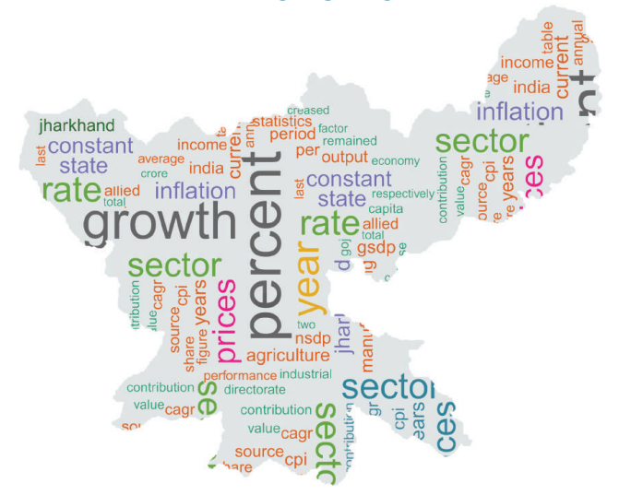
Government of Jharkhand Ease of Doing Business – Labour Reforms

Slide 2
Online Services
Factories Act
Map Approval
Licence : Registration | Renewal | Reinstate | Amendment
Boiler Act
Registration | Renewal
Other Labour Laws
Shops & Establishment Act : Registration | Amendment
Contract Labour Act : Principal Employer - Registration, Amendment | Contractor – Licence, Renewal, Amendment
Manufacturer | Erector | Repairer
Building & Other Construction Workers Act : Registration | Amendment

Slide 3
Online Services (New)
Motor Transport Workers Act
New Registration | Renewal | Backlog Registration | Amendment
Beedi & Cigar Workers Act
Licence | Renewal | Amendment
Inter-State Migrant Workmen Act
Principal Employer: Registration | Amendment
Contractor: Licence | Renewal | Amendment

Slide 4
Third Party Audit
Applicability
All medium risk industries can opt for third party audit provided they file annual returns online by 30th June
Audit Report
Third Party Auditor submits compliance report online with two-way communication between auditor and applicant
Information
Eligibility for scheme, list of auditors, and audit report can be checked on website by users

Slide 5
Self-Certification Scheme
Applicability
All industries can opt for this scheme by depositing security and filing annual return
Annual return to be filed by employers between 1st June to 30th June every year
Planned Inspection
One planned inspection in 5 years identified by random list of 20% units every year
Return filing

Slide 6
DIPP – Other Regulatory Reforms
Factories Act
Validity of Factory Licence / Renewal upto 10 years
Provision of Third Party Inspection for Boilers
Shops & Establishment Act
Shops & Establishment Registration within 1 day
Boilers Act

Slide 7
Single Integrated Return and Online Register
Single Integrated Return
Single Integrated Return for all applicable 14 labour laws
Return Filing – 1st June to 30th June
Simplified online return pro forma
Low Risk Industries who file annual return are exempted from departmental inspection
Online Register
Maintain registers online as compliance proof
Save and edit feature for real-time register maintenance

Slide 8
Inspection Reforms
Inspection procedure and checklist on portal
Risk Profiling and Computerized Risk Assessment
Computerized allocation of units to inspectors for joint synchronized inspection
Same inspector cannot inspect the same unit consecutively
Online inspection and compliance monitoring mechanism
Real-time inspection report submission through app
Two-Way Online Communication For Compliance After Inspection
Submission of show-cause by employer with file upload option.

Slide 9
Risk Classification

Slide 10
Inspection Report Submission

Slide 11
Inspection Report 48 Hours

Slide 12
THANK YOU
Navneet Kumar
+91 97899 01073
navneet1.kumar@in.ey.com

